Slide 1
CREDIT CARD DEFAULT PREDICTION
Submitted by:
Ramdas Prajapati

Slide 2
OVERVIEW
Banking/Financial Institutes plays a significant role in providing financial service.
To maintain the integrity, bank/institute must be careful when investing in customers to avoid financial loss.
Before giving credit to borrowers , the bank must come to about the potential of customers.
The term credit scoring, determines the relation between defaulters and loan characteristics.

Slide 3
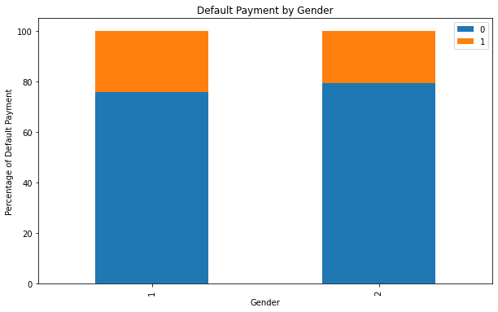
Gender (1:- Male, 2 :- Female)
By analyzing the plot, we can observe the following:
The default payment percentage is higher for males compared to females.
The difference in default payment behavior between genders is significant.

Slide 4
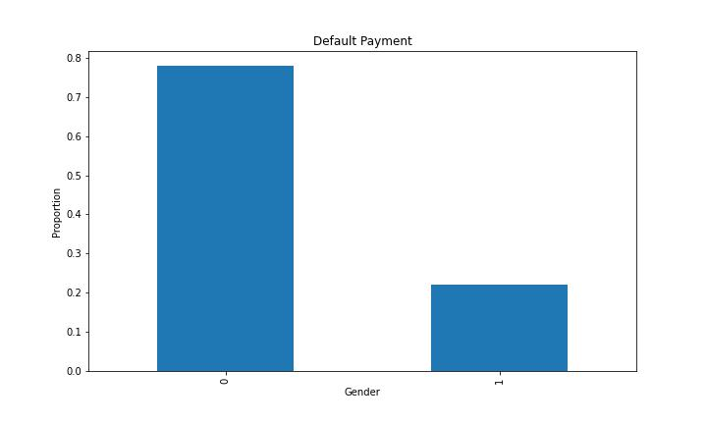
Default payment( 1: Yes & 0: No)
Our dataset is Highly imbalanced.
Around 79% of observation is not making payments default where as 21% of observation making payments default.

Slide 5
DATA PREPROCESSING
Data set is divided in 70:30 ratio for train and test respectively.
ID column was dropped as its unnecessary for our modeling.
The attribute name ‘PAY_0’was converted to ‘PAY_1’ and 'default.payment.next.month’ was coverted to ‘Default_payment’ for naming convenience.
Pay_0:No consumption of credit card=-2,Pay duly(paid on time)=-1,payment delay for one mouth=1, payment delay for two months=2,payment delay for nine months and above=-9.
No Null values in dataset
No duplicates values in the dataset

Slide 6
Imbalance Class treatment
RandomOverSampler :
is a technique used in machine learning to address the problem of imbalanced datasets. Imbalanced datasets occur when the number of instances in one class is significantly higher or lower than the number of instances in another class. This can lead to biased models that perform poorly on the minority class.
RandomOverSampler works by randomly duplicating instances from the minority class until the dataset is balanced. This technique helps to increase the representation of the minority class and provides more training examples for the model to learn from.

Slide 7
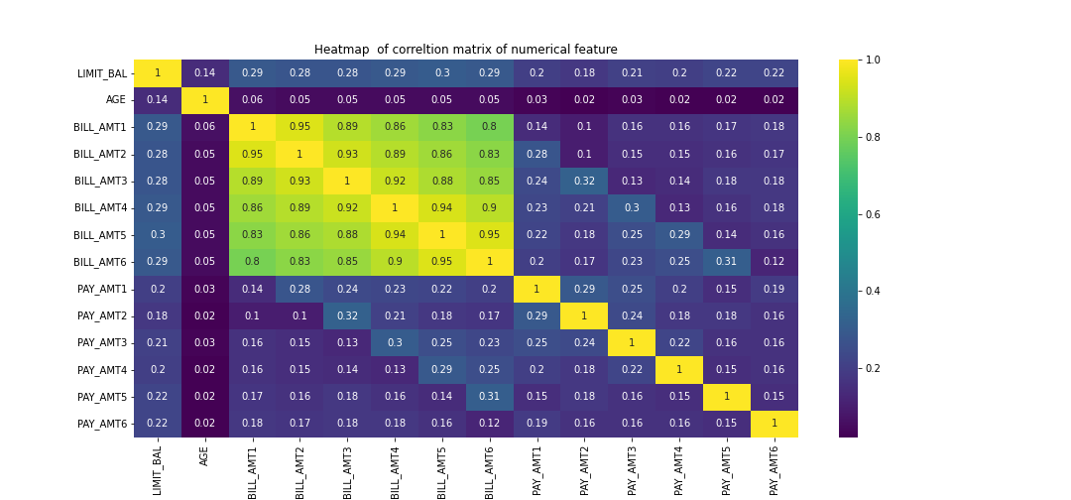
Feature Selections

Slide 8
Feature selection is a crucial step in machine learning, especially for classification problems. It involves selecting a subset of relevant features from the original dataset to improve the performance of the classification model. By reducing the number of features, we can simplify the model, reduce overfitting, and improve interpretability.
There are several feature selection techniques that can be used for classification problems. Here are a few commonly used ones:
Filter Methods: These methods rank features based on statistical measures like correlation, chi-square, or information gain. Features with high scores are selected. Examples include Pearson's correlation coefficient and mutual information.
Our best selected features are BALANCE LIMIT pay_1,pay_2,pay_3,…up to pay_6 and pay_amt1,pay_amt2,pay_amt4.

Slide 9
OUTLIER STUDY & TREATMENT
An outlier is an observation that lies an abnormal distance from other values in a random sample from a population.
We observe that LIMIT_BAL, PAY_AMT1, PAY_AMT2 and PAY_AMT4 are numerical features are normally distributed having outlier
Outlier observation :- data point which lie above upper limit or below lower limit .
Upper_limit, lower_limit = mean(feature)+3*std(feature), mean(feature)-3*std(feature)

Slide 10
Voting classifier
A voting classifier is a machine learning algorithm that combines the predictions of multiple individual classifiers to make a final prediction. In a voting classifier, each individual classifier is trained on the same dataset using different algorithms or configurations. These classifiers can be of different types, such as decision trees, support vector machines, or neural networks. Each classifier independently makes a prediction, and the final prediction is determined by a majority vote or by taking the average of the individual predictions.

Slide 11
CONCLUSION
We investigated the data, checking for data unbalancing, visualizing the features and understanding the relationship between different features.
We used train-test split to evaluate the model effectiveness to predict the target value i.e. detecting if a credit card will default next month.
We started with decision tree ,random forest, svc, adaboost,logistic regression ridge classifier naive bayes all model give different accuracy
We choose voting classifier finally.
This would also inform the issuer’s decisions on who to give a credit card to a and what credit limit to provide.

Slide 12
Any Question

Slide 13

THANK YOU

